Slide 1
A+ Academy Quiz Application
Jason Duncan, Harsh Patel, Lam Nguyen

Slide 2

Introduction
Our goal was to create an application that would allow administrators to:
Block users
Create quizzes
Create questions
View user data
And to allow users to:
Take quizzes
Get a rank for performance on quizzes
View rankings between other users
Get rewards based on rankings
Have a free or paid subscription

Slide 3
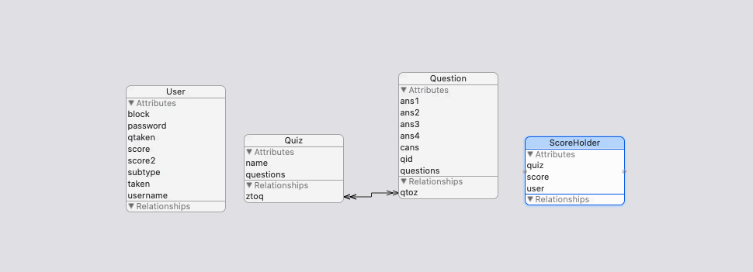
Database
Entities:
User
Quiz
Question
ScoreHolder

Slide 4
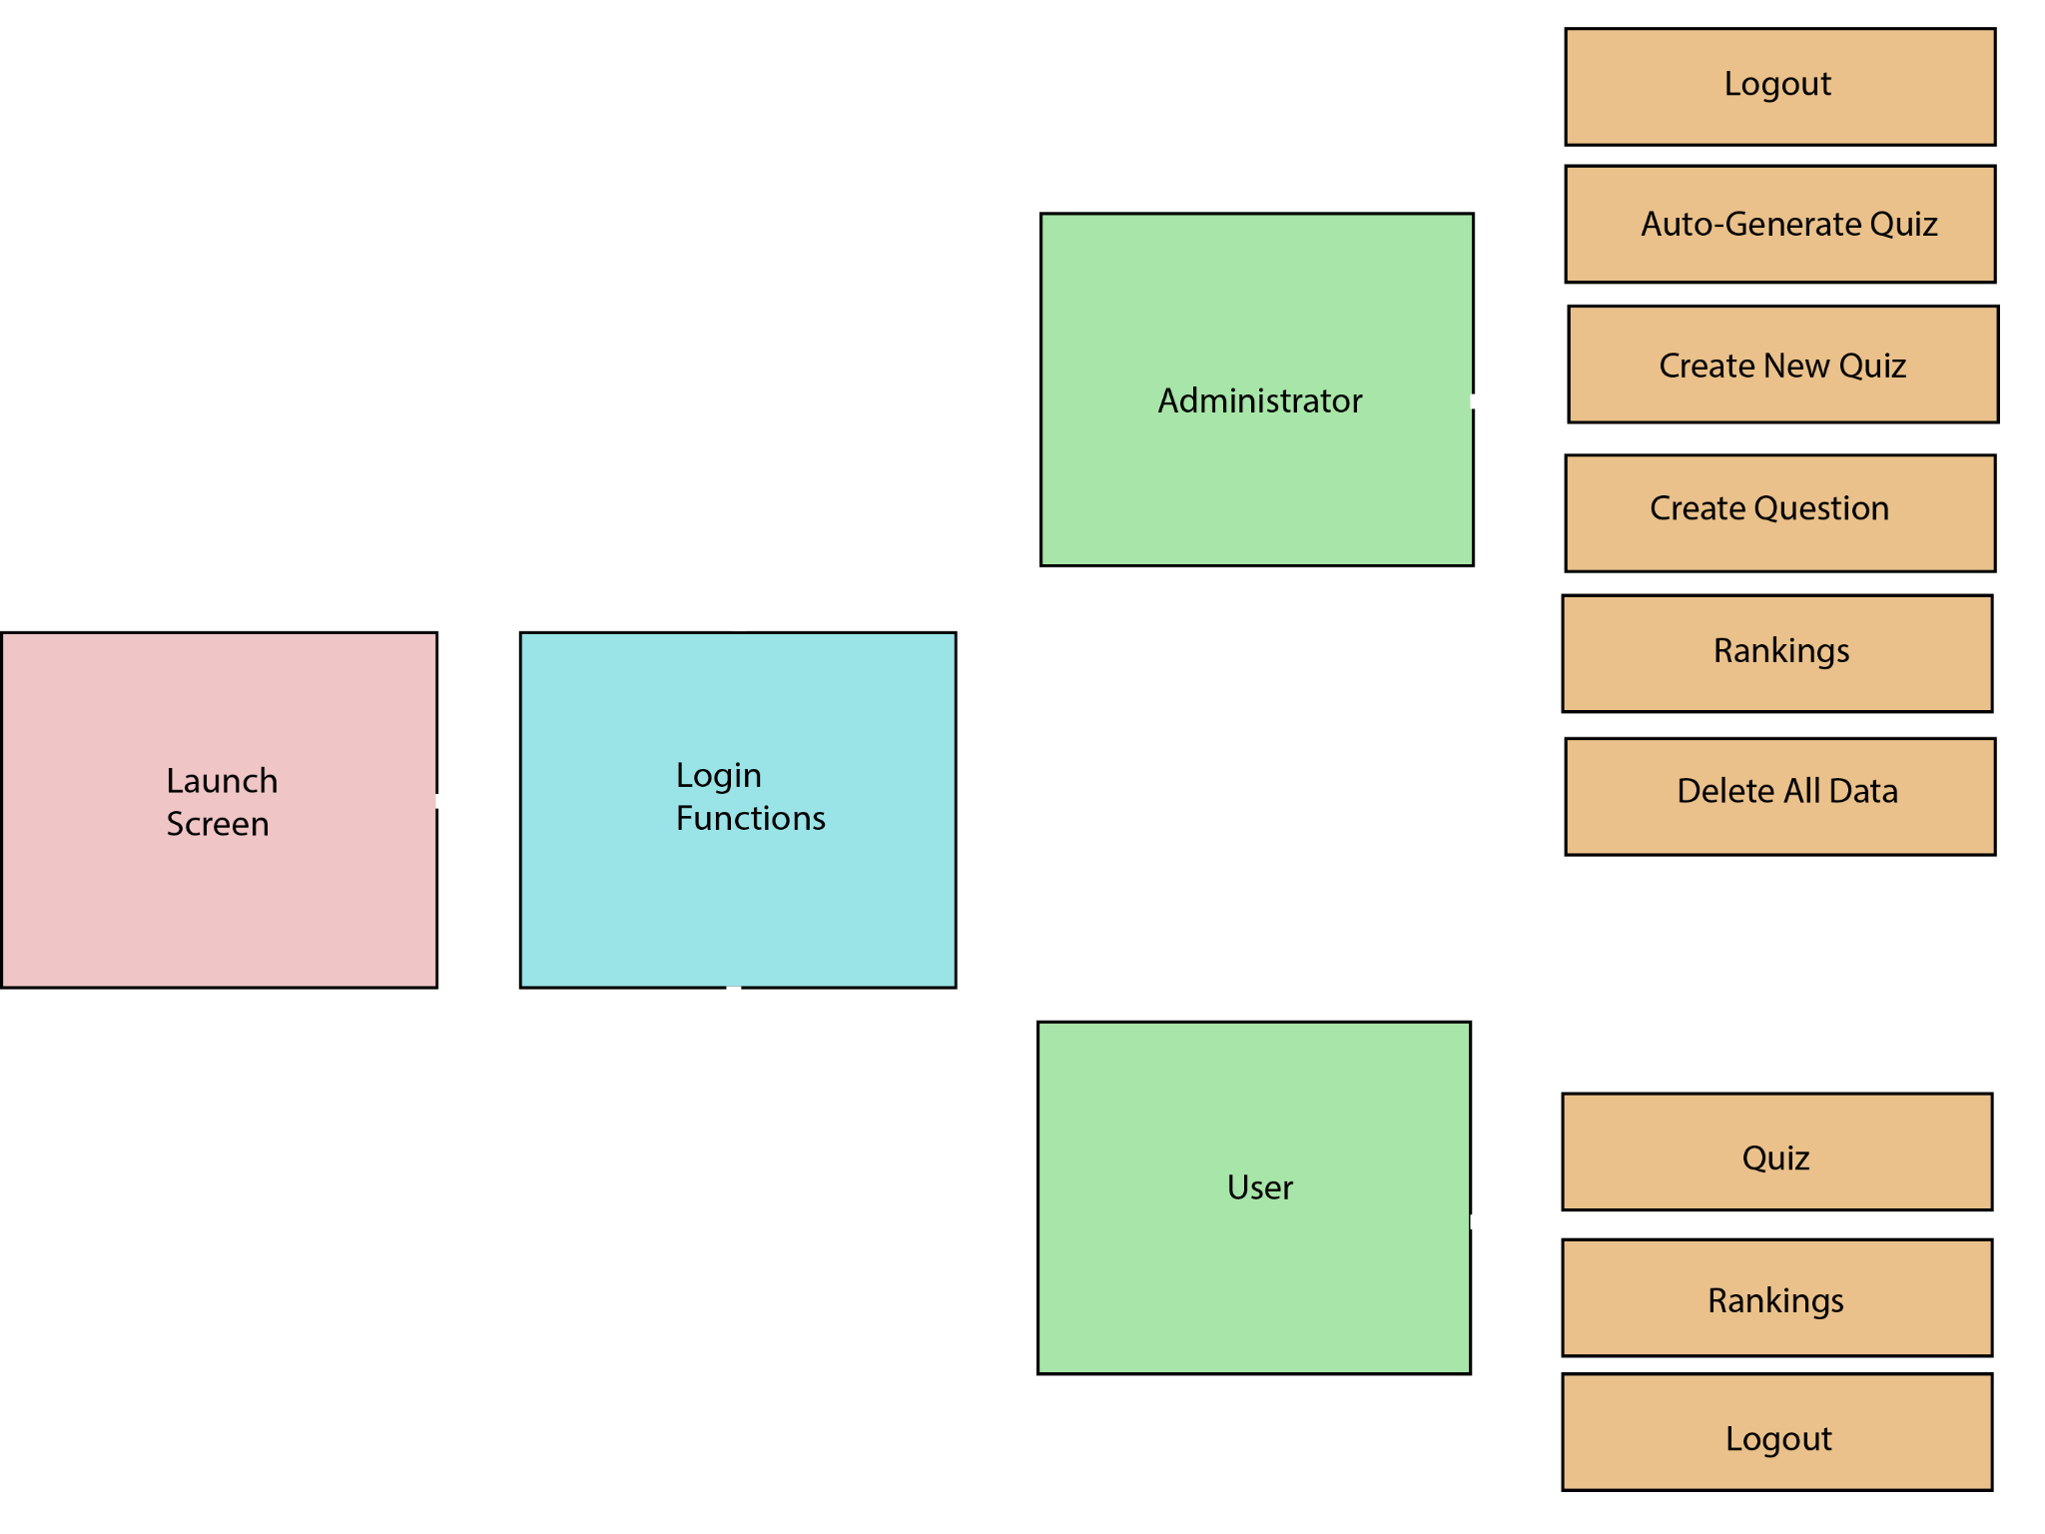
Application Flow Chart

Slide 5
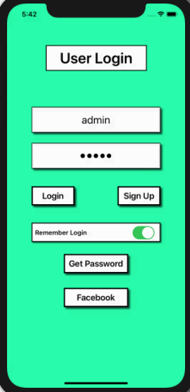
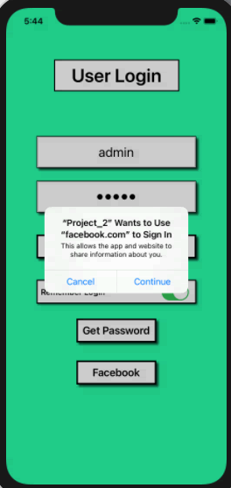
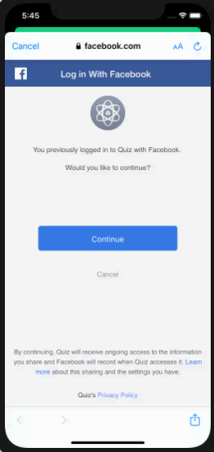

Slide 6
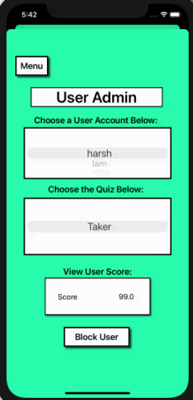
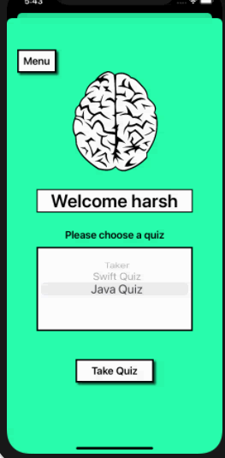
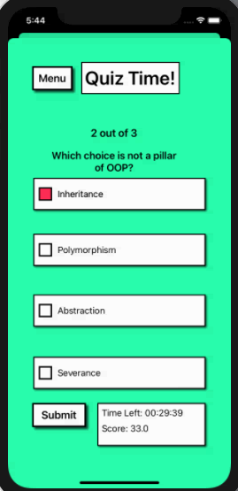

Slide 7
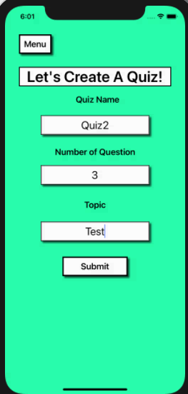
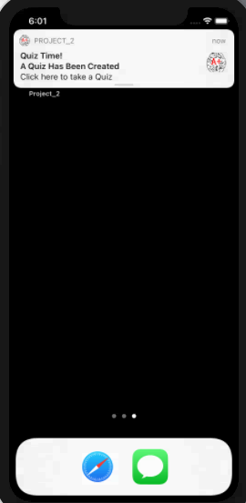

Slide 8
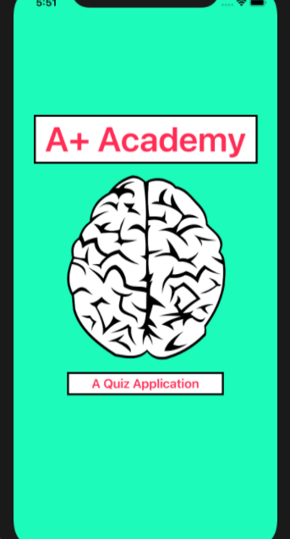
User Interface
What was the reasoning / Inspiration for the design?
Why choose the color scheme?
Application Flow Design Decisions?

